Slide 1
Quick Sort

Slide 2
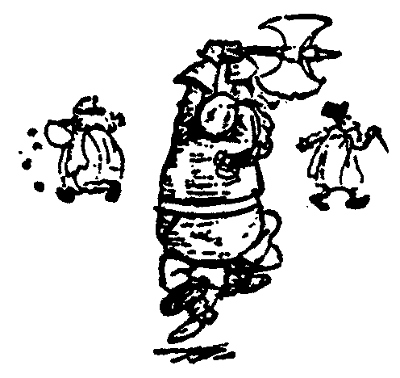
Quick Sort
88
52
14
31
98
25
30
62
23
79
Divide and Conquer

Slide 3
Quick Sort
Partition set into two using randomly chosen pivot
88
52
14
31
98
25
30
62
23
79
14
88
98
31
30
≤ 52 ≤
62
25
23
79

Slide 4
Quick Sort
14
88
98
31
30
≤ 52 ≤
62
25
23
79
sort the first half.
sort the second half.
14,23,25,30,31
62,79,98,88

Slide 5
Quick Sort
14,23,25,30,31
52
62,79,88,98
Glue pieces together.
(No real work)
14,23,25,30,31,52,62,79,88,98

Slide 6
i
p
q
11 | 2 | 9 | 13 | 57 | 25 | 17 | 1 | 90 | 3
lower
upper
i
p
q
11 | 2 | 9 | 13 | 57 | 25 | 17 | 1 | 90 | 3
i
p
q
11 | 2 | 9 | 3 | 57 | 25 | 17 | 1 | 90 | 13
i
p
q
11 | 2 | 9 | 3 | 57 | 25 | 17 | 1 | 90 | 13
i
p
q
11 | 2 | 9 | 3 | 1 | 25 | 17 | 57 | 90 | 13

Slide 7
i
q
p
11 | 2 | 9 | 3 | 1 | 25 | 17 | 57 | 90 | 13
1 | 2 | 9 | 3 | 11 | 25 | 17 | 57 | 90 | 13
4
11
4

Slide 8
Sort Left Half
2
1
i
p
q
i
p
q
1 | 2 | 9 | 3
9 | 3
arr[q]>9
3>9: No
i
p
1 | 2 | 9 | 3
3 | 9
q
1
2
i
p
q
0
2 | 9 | 3
3
2
9
i
p
2 | 9 | 3
3
q

Slide 9
Sort Right Half
i
p
q
i
p
q
13 | 17
arr[q]>13
17>13: Yes
q--;
25 | 17 | 57 | 90 | 13
5
6
7
8
9
i
p
i
p
q
13 | 17
25 | 17 | 57 | 90 | 13
q
i
q
p
5
25 | 17 | 13 | 90 | 57
17
13
6
5
13 | 17 | 25 | 90 | 57
7

Slide 10
Sort Right Half
i
p
q
arr[q] > 90
57>90: No
90 | 57
57 | 90
8
9
90
57
8
9

Slide 11
Glue Pieces Together
1 | 2 | 3 | 9
11
13 | 17 | 25 | 57 | 90
0
1
2
3
4
5
6
7
8
9

Slide 12
Entire Array is sorted!!!
1 | 2 | 3 | 9 | 11 | 13 | 17 | 25 | 57 | 90

Slide 13
C-Function for Quicksort
void quicksort ( int a[ ], int lower, int upper )
{
int i ;
if ( upper > lower )
{
i = split ( a, lower, upper ) ;
quicksort ( a, lower, i - 1 ) ;
quicksort ( a, i + 1, upper ) ;
}
}

Slide 14
C-Function for Quicksort
int split ( int a[ ], int lower, int upper )
{
int i, p, q, t ;
p = lower + 1 ;
q = upper ;
i = a[lower] ;

Slide 15
C-Function for Quicksort
while ( q >= p )
{
while ( a[p] < i )
p++ ;
while ( a[q] > i )
q-- ;
if ( q > p )
{
t = a[p] ;
a[p] = a[q] ;
a[q] = t ;
}
}

Slide 16
C-Function for Quicksort
t = a[lower] ;
a[lower] = a[q] ;
a[q] = t ;
return q ;
}

